Slide 1
SQL Server Administration
Slides - https://beard.media/passpreconslides
Demos - https://beard.media/precondemo
Docker pull dbatools/sqlinstance
Docker pull dbatools/sqlinstance
Docker pull mcr.microsoft.com/mssql/server:2019-CTP3.2-ubuntu
New-Item C:\MSSQL\BACKUP\KEEP –ItemType Directory
$cred = Get-Credential # (Use username sqladmin Password dbatools.IO)
$cred | Export-CLiXml C:\MSSQL\BACKUP\sqladmin.cred
Download AdventureWorks2012.bak
https://beard.media/AdventureWorks2012
and move to that directory
made easy with dbatools

Slide 2
SQL Server Administration
made easy with dbatools
Rob Sewell - Sewells Consulting Ltd

Slide 5

Rob Sewell
Bearded Consultant, Automator,
Trainer
Consultant Sewells Consulting Ltd
beard.media/book dbachecks PowerShell & Data Community
/robsewellsqldba
@sqldbawithbeard
SQLDBAWithABeard.com

Slide 6
What are we going to talk about?

Slide 7

Slides - https://beard.media/passpreconslides
Demos - https://beard.media/precondemo
Photo by Matthew Henry on Unsplash

Slide 8


Slide 9
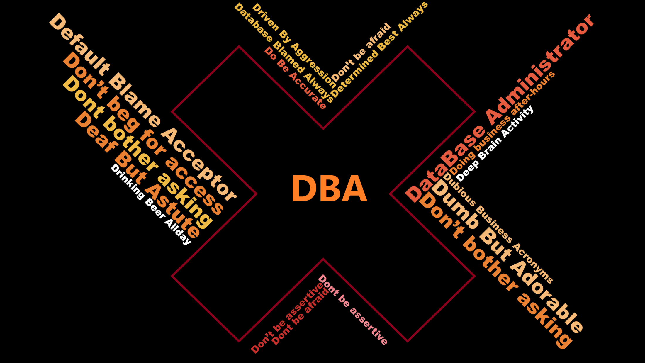

Slide 10
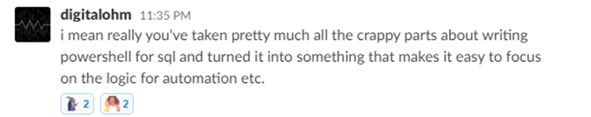
What is dbatools?

Slide 11

What is dbatools? – basically

Slide 12
What is dbatools? – actually
Photo by Kasya Shahovskaya on Unsplash

Slide 13

What is dbatools? – well basically
Notes:
We make it easy

Slide 14

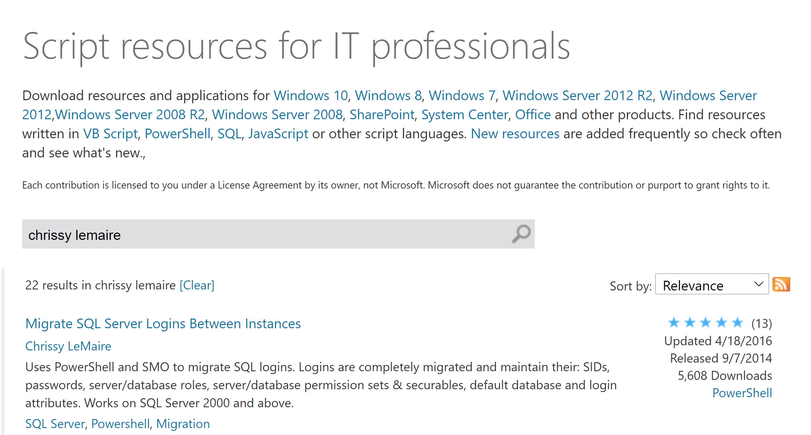
07/2014
Published to GitHub & ScriptCenter
07/2014
Need to Migrate Sharepoint databases
Microsoft Script Center

Slide 15
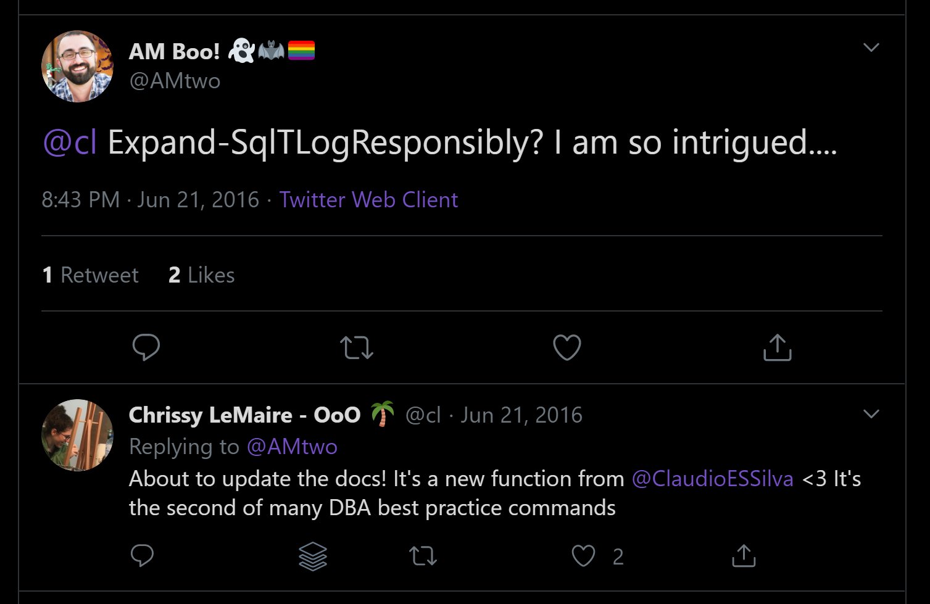
07/2014
Published to GitHub & ScriptCenter
07/2014
06/2016
Need to Migrate Sharepoint databases
First Community Contributions

Slide 16
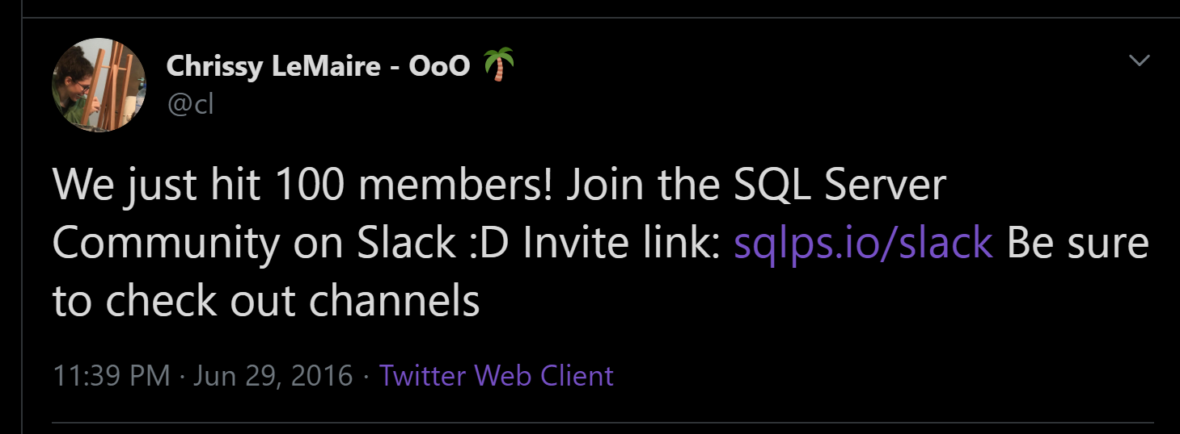
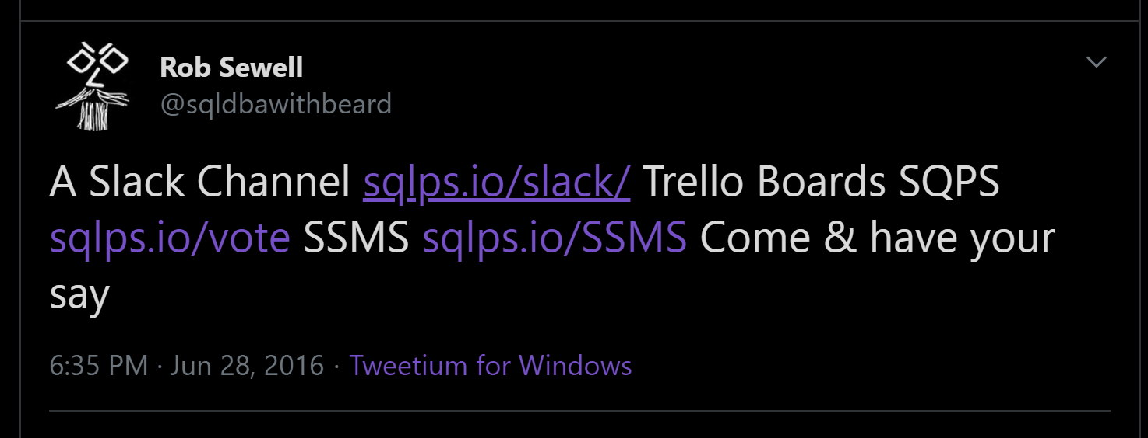
07/2014
06/2016
Published to GitHub & ScriptCenter
SQL Community Slack Was Born
07/2014
06/2016
Need to Migrate Sharepoint databases
First Community Contributions

Slide 17
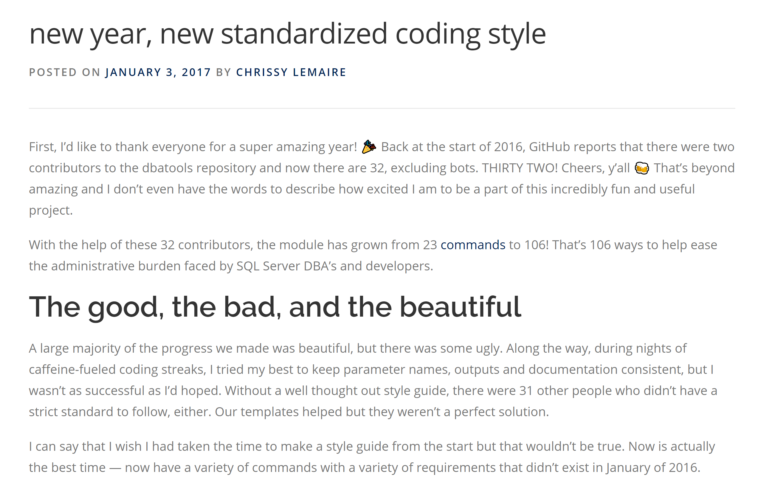
07/2014
06/2016
32 Contributors
Published to GitHub & ScriptCenter
SQL Community Slack Was Born
07/2014
06/2016
01/2017
Need to Migrate Sharepoint databases
First Community Contributions
The Road to 1.0 starts

Slide 19
07/2014
06/2016
32 Contributors
Published to GitHub & ScriptCenter
SQL Community Slack Was Born
07/2014
06/2016
01/2017
Need to Migrate Sharepoint databases
First Community Contributions
The Road to 1.0 starts

Slide 20
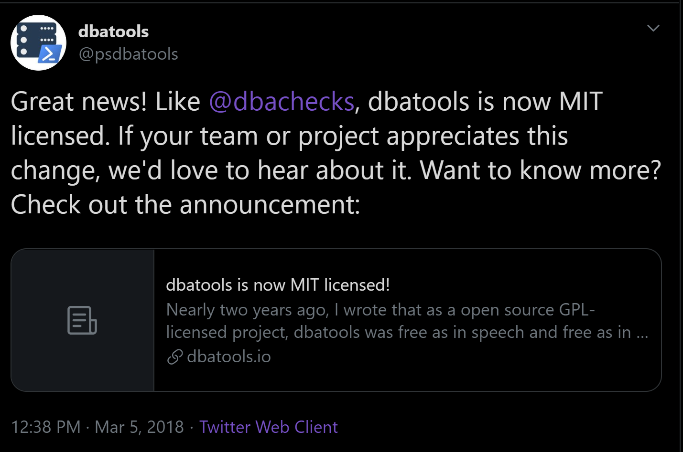
07/2014
06/2016
32 Contributors
Published to GitHub & ScriptCenter
03/2018
SQL Community Slack Was Born
MIT Licence
07/2014
06/2016
01/2017
Need to Migrate Sharepoint databases
First Community Contirbutions
The Road to 1.0 starts

Slide 21
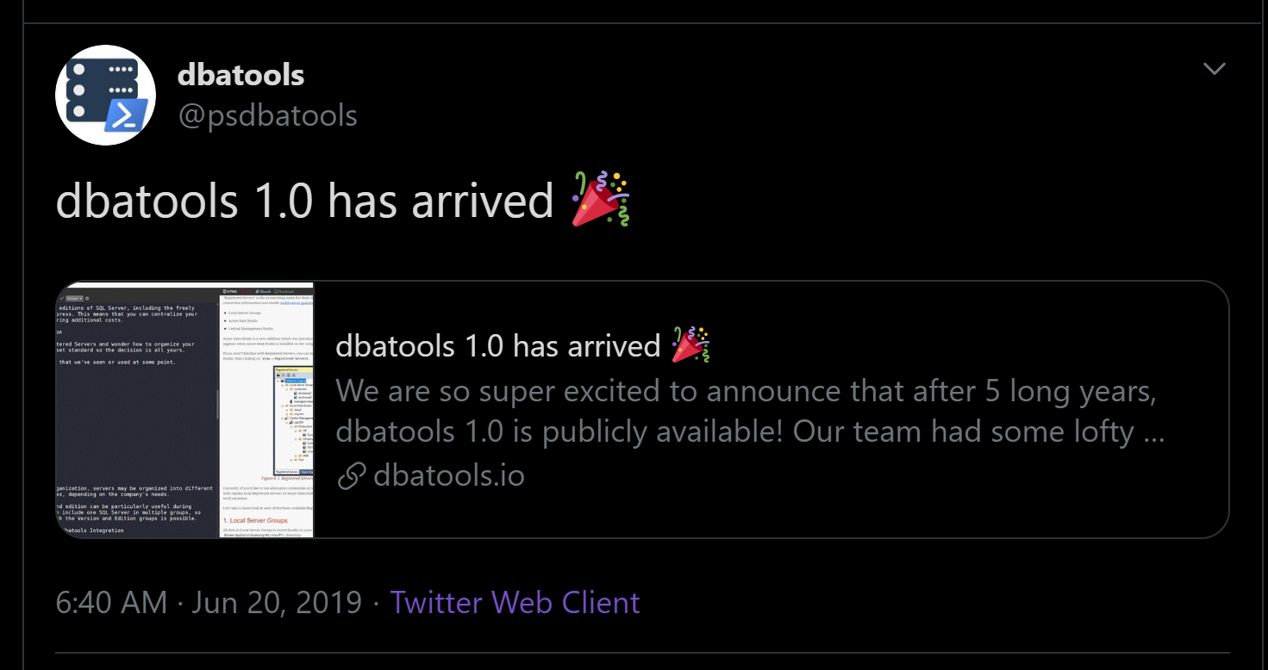
07/2014
06/2016
32 Contributors
Published to GitHub & ScriptCenter
03/2018
SQL Community Slack Was Born
MIT Licence
06/2016
01/2017
06/2019
07/2014
First Community Contirbutions
The Road to 1.0 starts
Dbatools 1.0
Need to Migrate Sharepoint databases

Slide 22
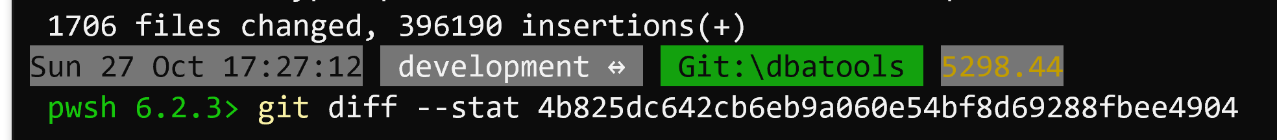
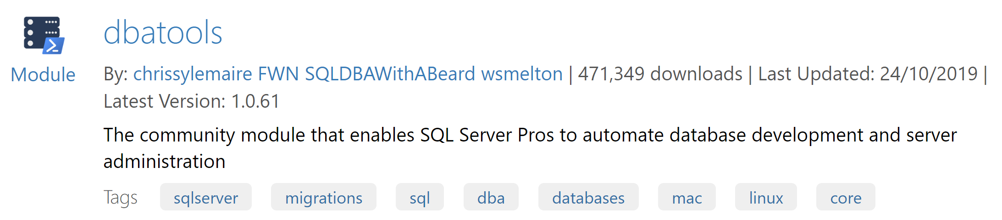
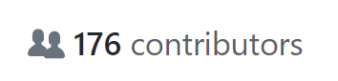
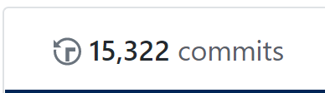
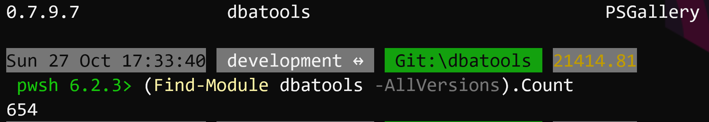
07/2014
06/2016
32 Contributors
Published to GitHub & ScriptCenter
03/2018
11/2019
SQL Community Slack Was Born
MIT Licence
06/2016
01/2017
06/2019
07/2014
First Community Contirbutions
The Road to 1.0 starts
Dbatools 1.0
Need to Migrate Sharepoint databases

Slide 23


























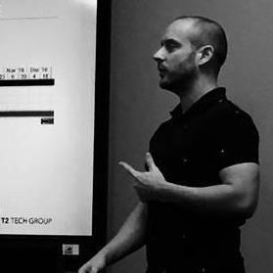


















07/2014
06/2016
32 Contributors
Published to GitHub & ScriptCenter
SQL Community Slack Was Born
03/2018
11/2019
MIT Licence
07/2014
06/2016
01/2017
06/2019
Need to Migrate Sharepoint databases
First Community Contributions
The Road to 1.0 starts
Dbatools 1.0

Slide 24
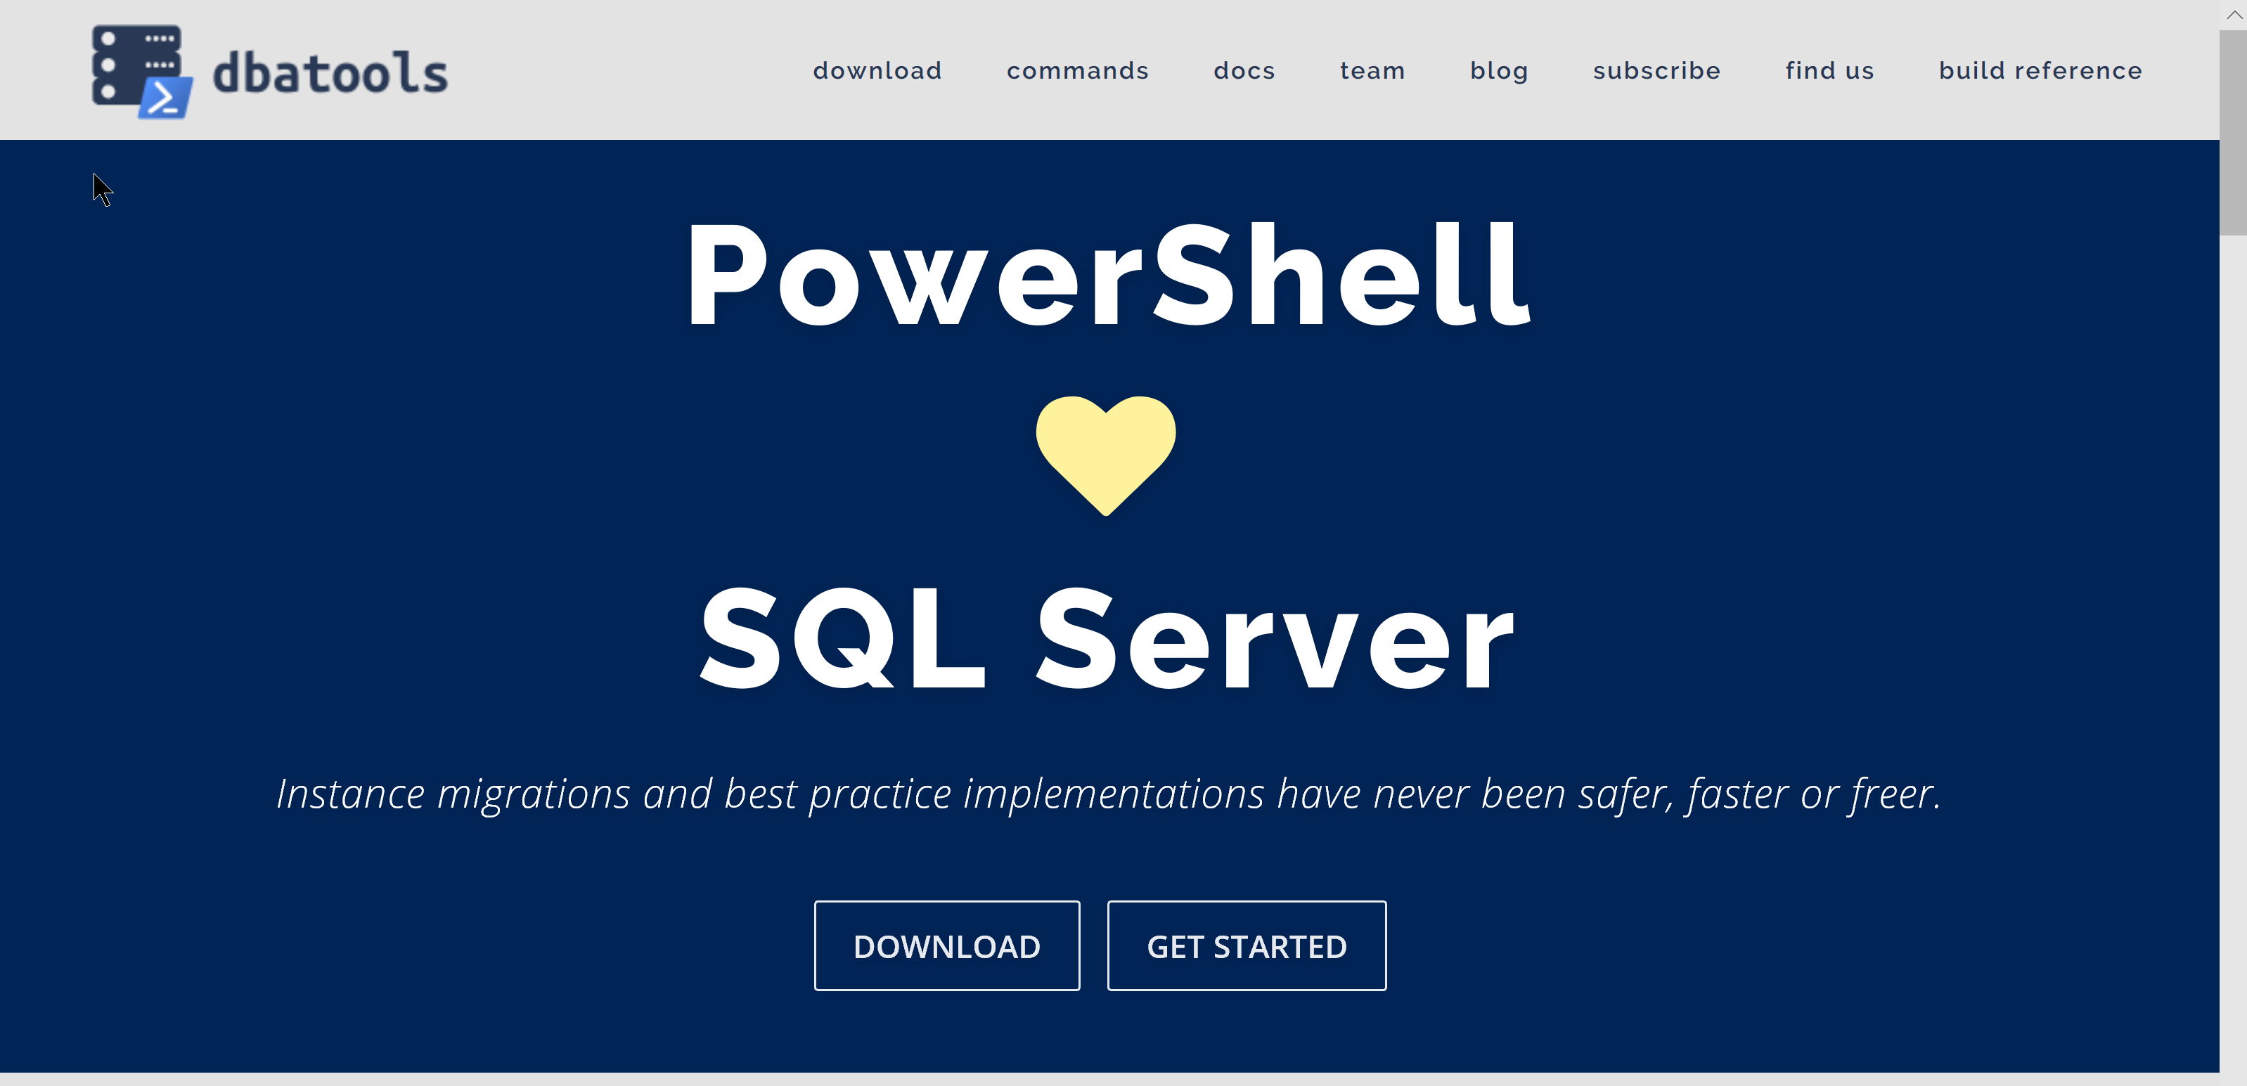
dbatools.io

Slide 25

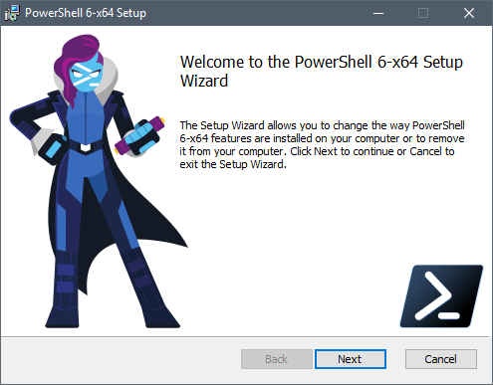
Client
PowerShell v5.1
Client
PowerShell v3
Better
Some functionality is not available
Also consider PowerShell Core pwsh
Cross Platform

Slide 26

Support
SQL Server 2000 – 2019 *
Express – Enterprise Edition
Clustered and stand-alone instances
Windows and SQL authentication
Default and named instances
Multiple instances on one server
What about Azure?
Notes:
* Azure

Slide 27
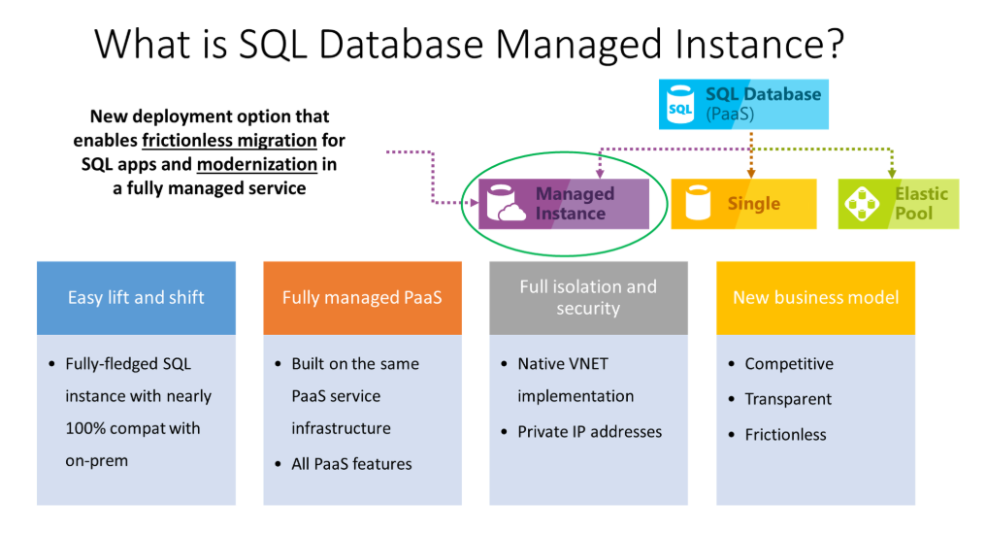
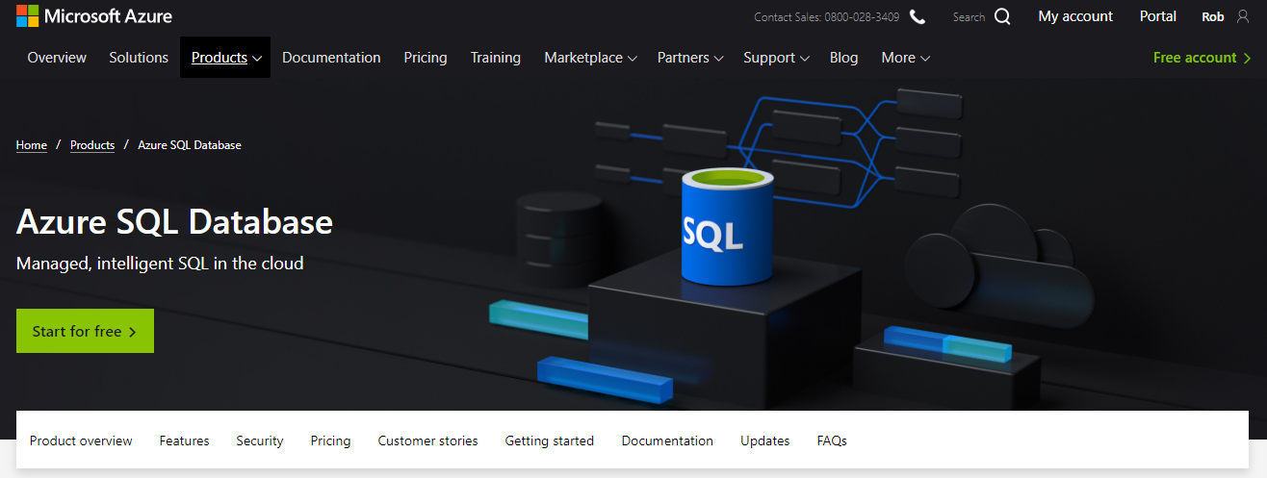
What about Azure?
Notes:
* Azure

Slide 29
Rob Sewell
@SQLDBAWithBeard
mrrobsewell@outlook.com

